Slide 1
Life-x cop
Solution training
Hannah Goeritz, Frequentis
02/10/2018 - Valabre

Slide 2
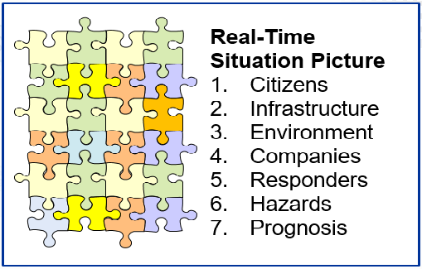
Life-X COP – the common operational picture
Effectively exchange crisis management (CM) information
Motivation
COP Approach
CM information is often distributed
Information sharing often done by e-mail, phone, …
Information is collected in a well structured way and shared among involved organizations
2
2

Slide 3
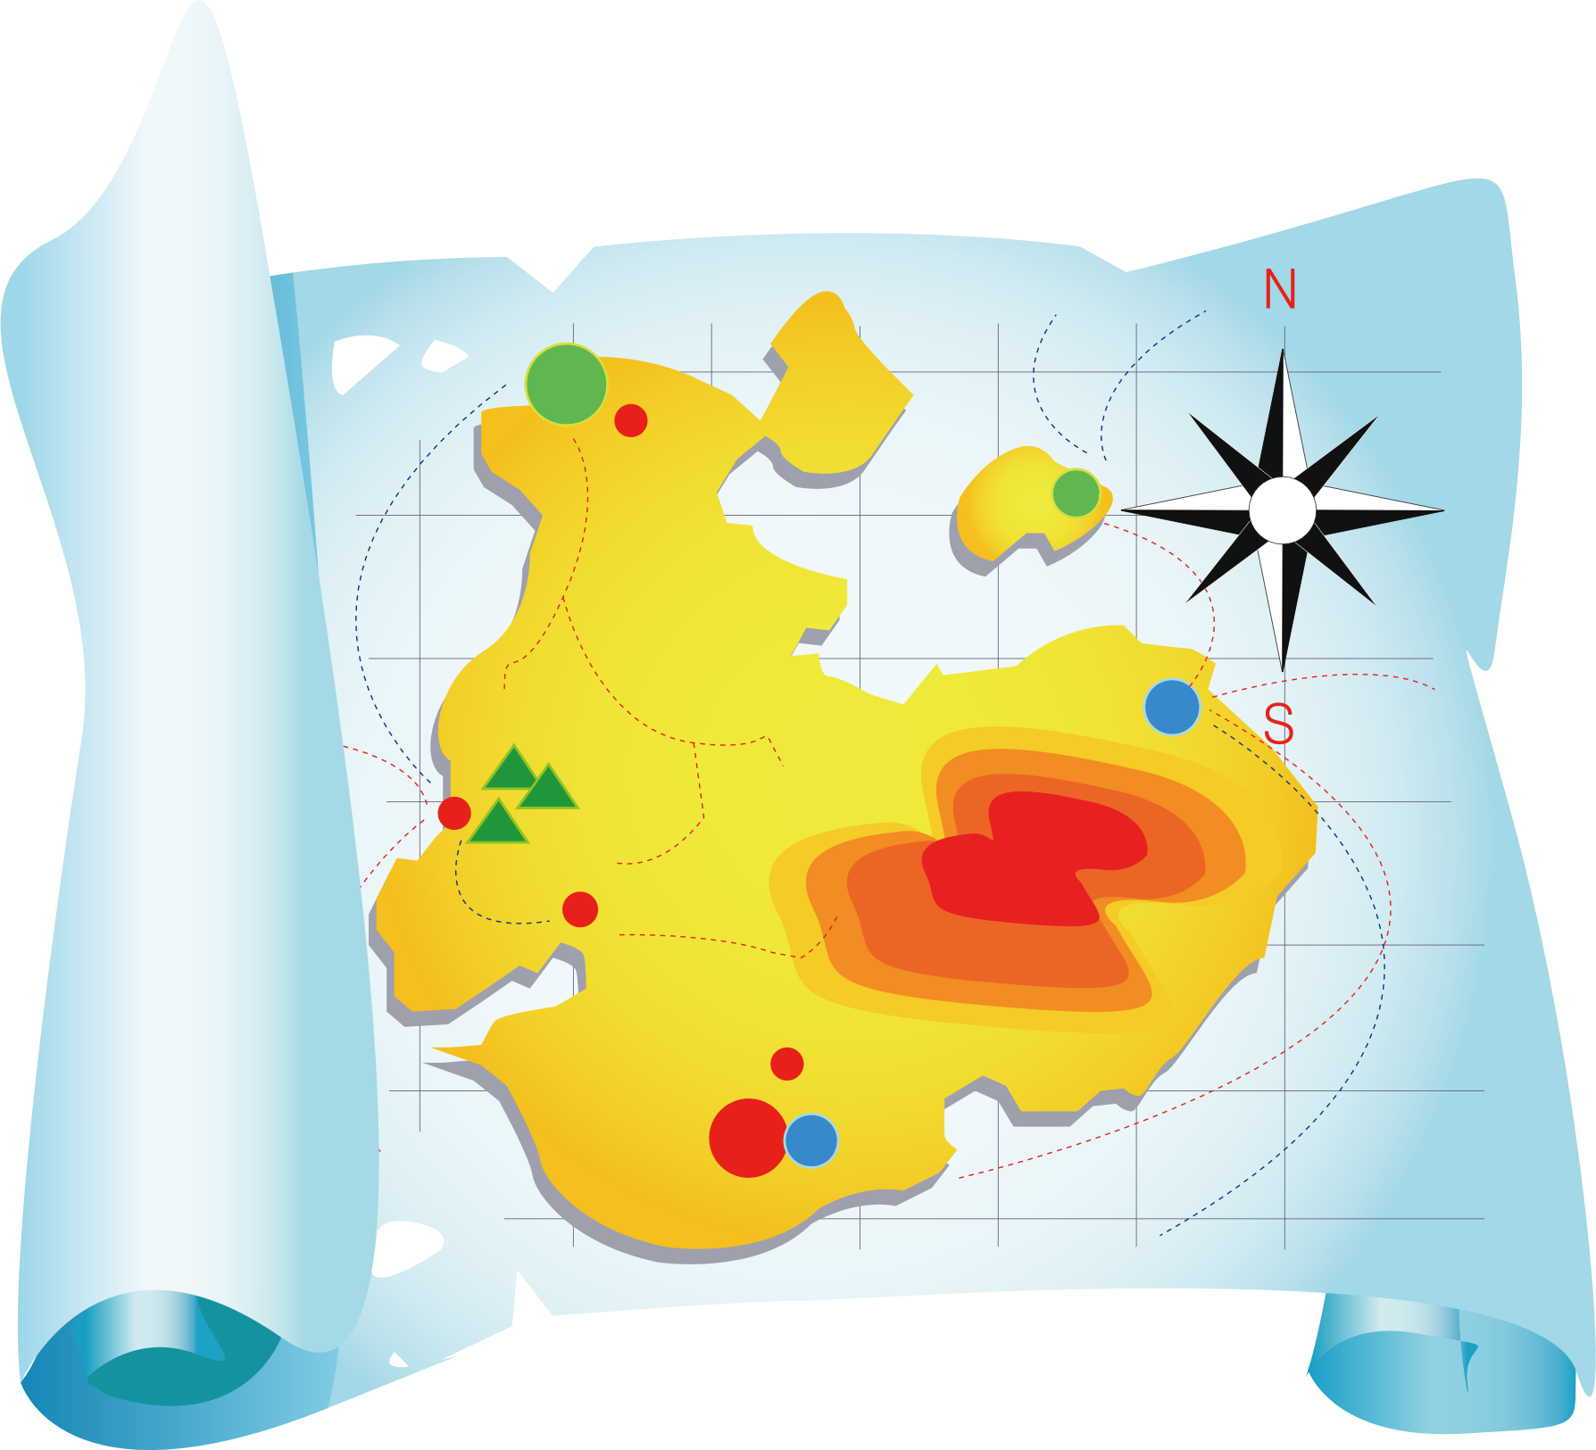
Life-x cop
Some facts
X
Prototype
already used successfully in other projects
constantly evolving
Online application – no client installation needed
Map based

Slide 4
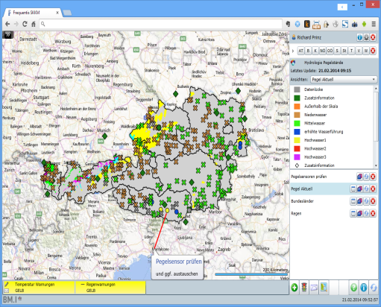
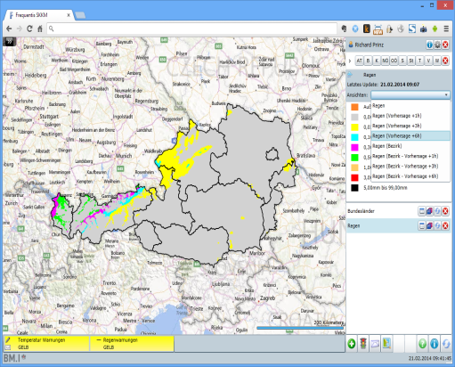
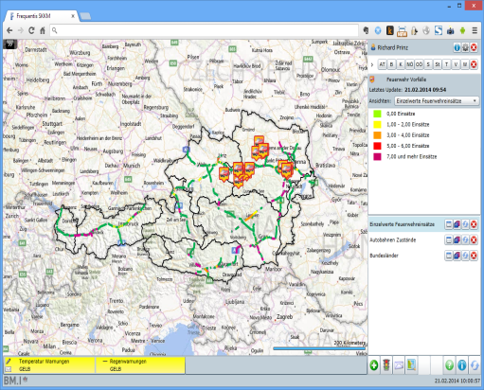
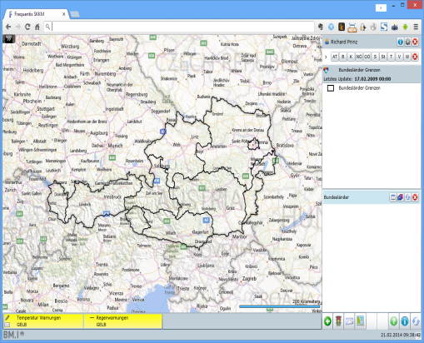
Life-x coP
Sensor information
Hazard information
Status of infrastructure
Traffic situation, weather forecast
Status of Responder Units
……….

Slide 5
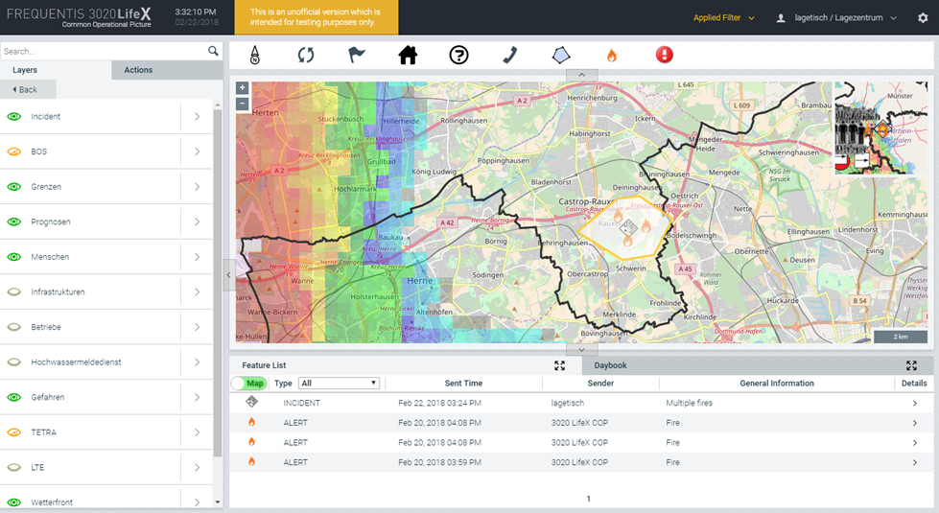
Life-x cop

Slide 6
Training

Slide 7
Life-x cop
Training - OUTline
Live demonstration
Overview of the COP and its functions
Interactive training
Specific functions that might be needed during the trial
Give it a try!

Slide 8
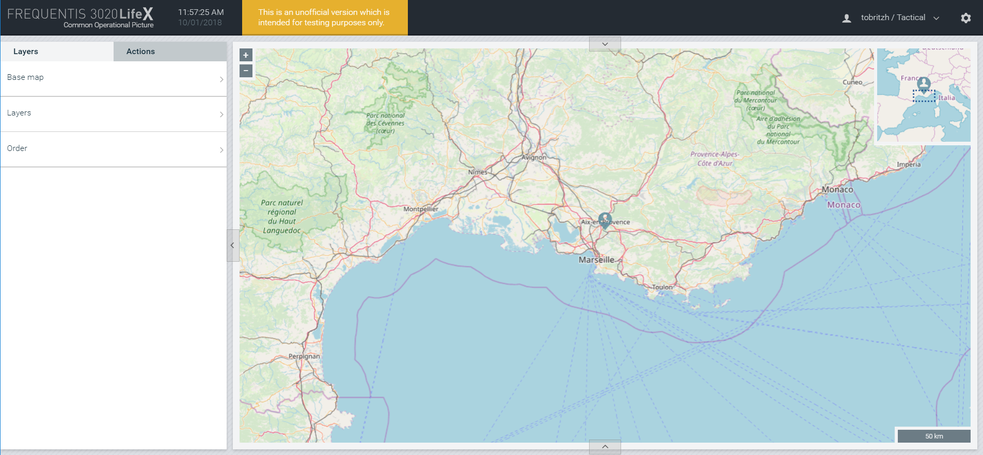
Base map

Slide 9
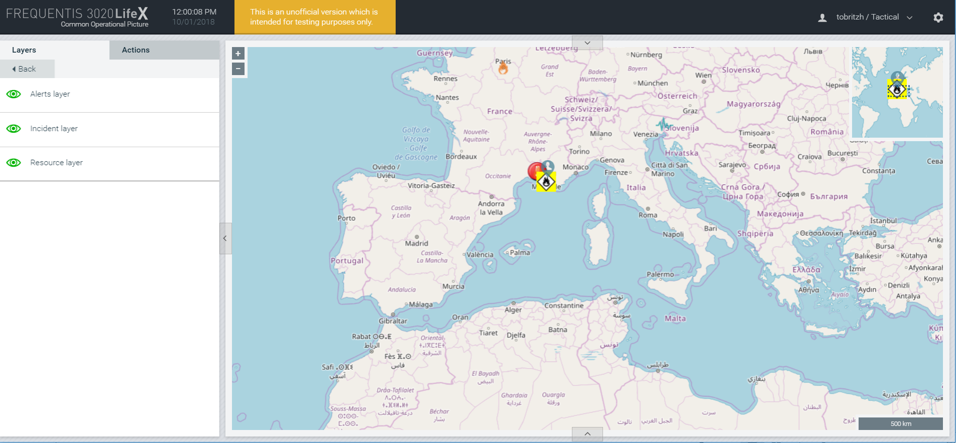
Layer visibility

Slide 10
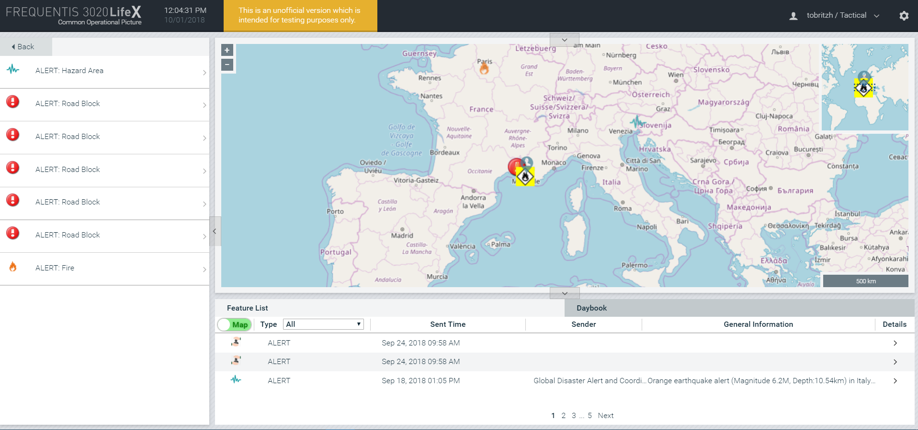
Lists of Features

Slide 11
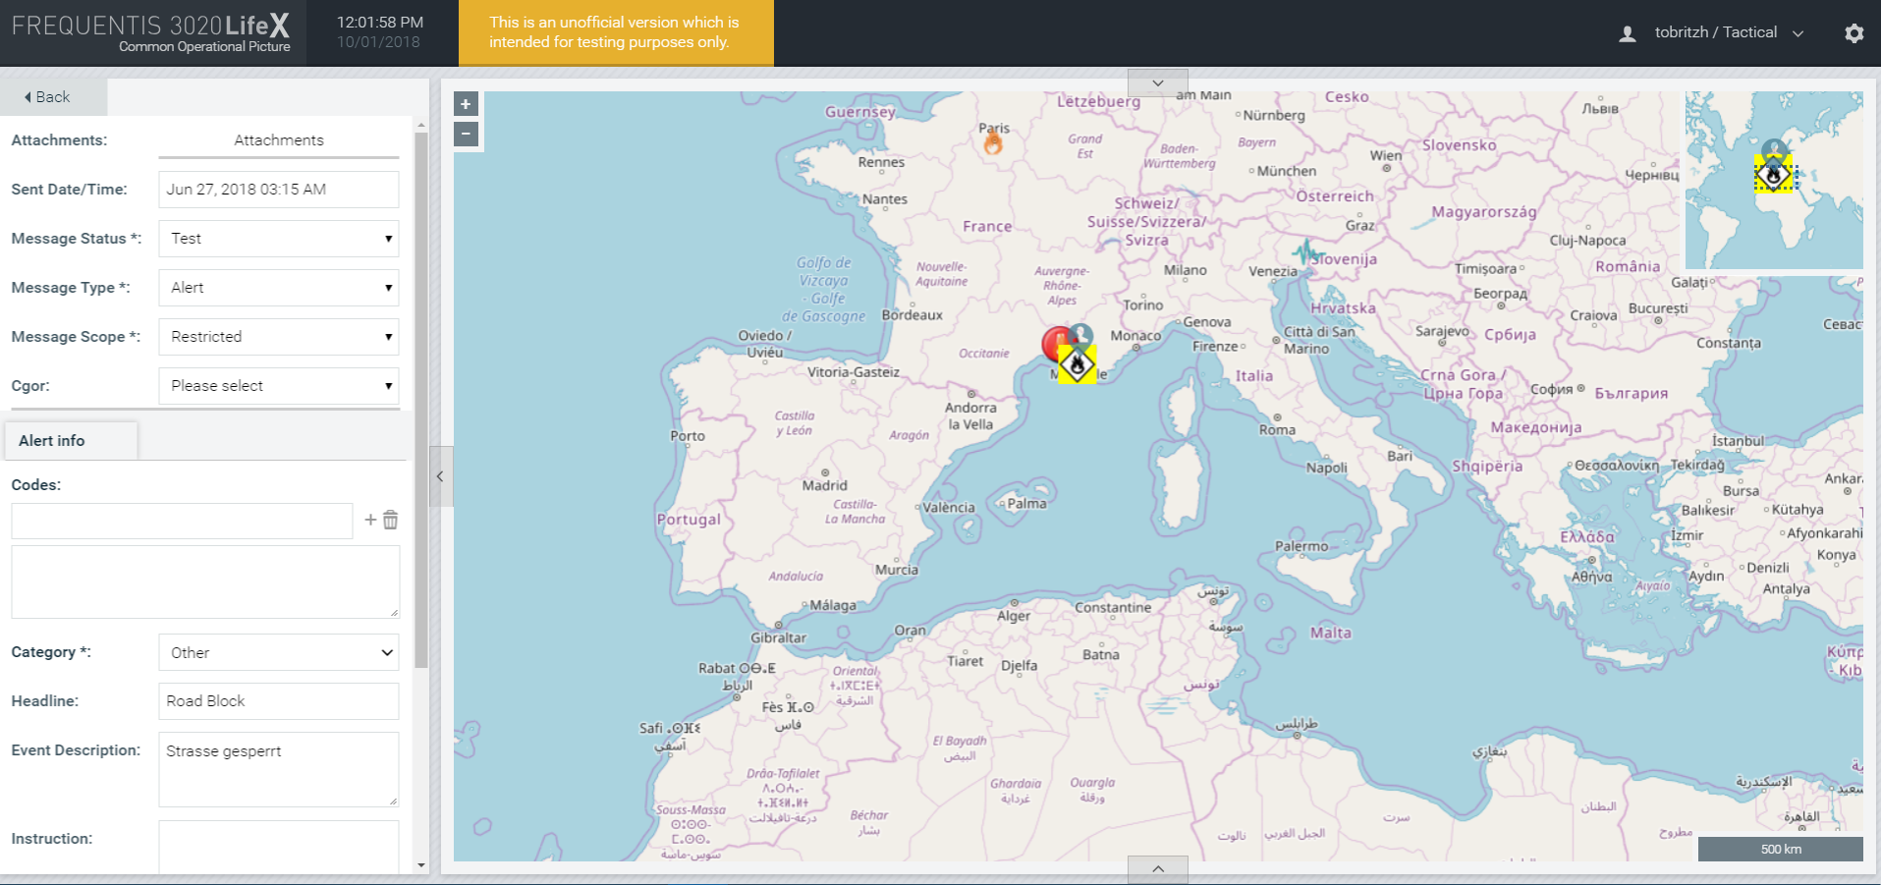
Details of an alert

Slide 12
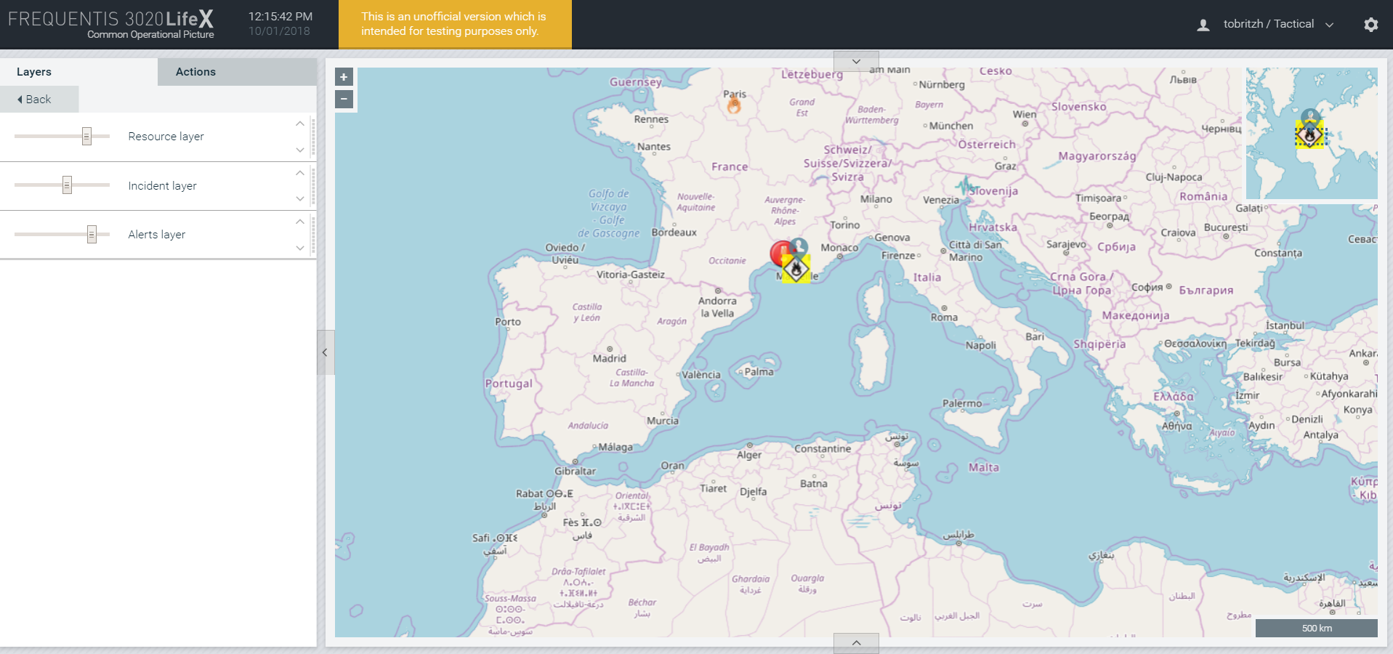
Order of layers and their opacity

Slide 13
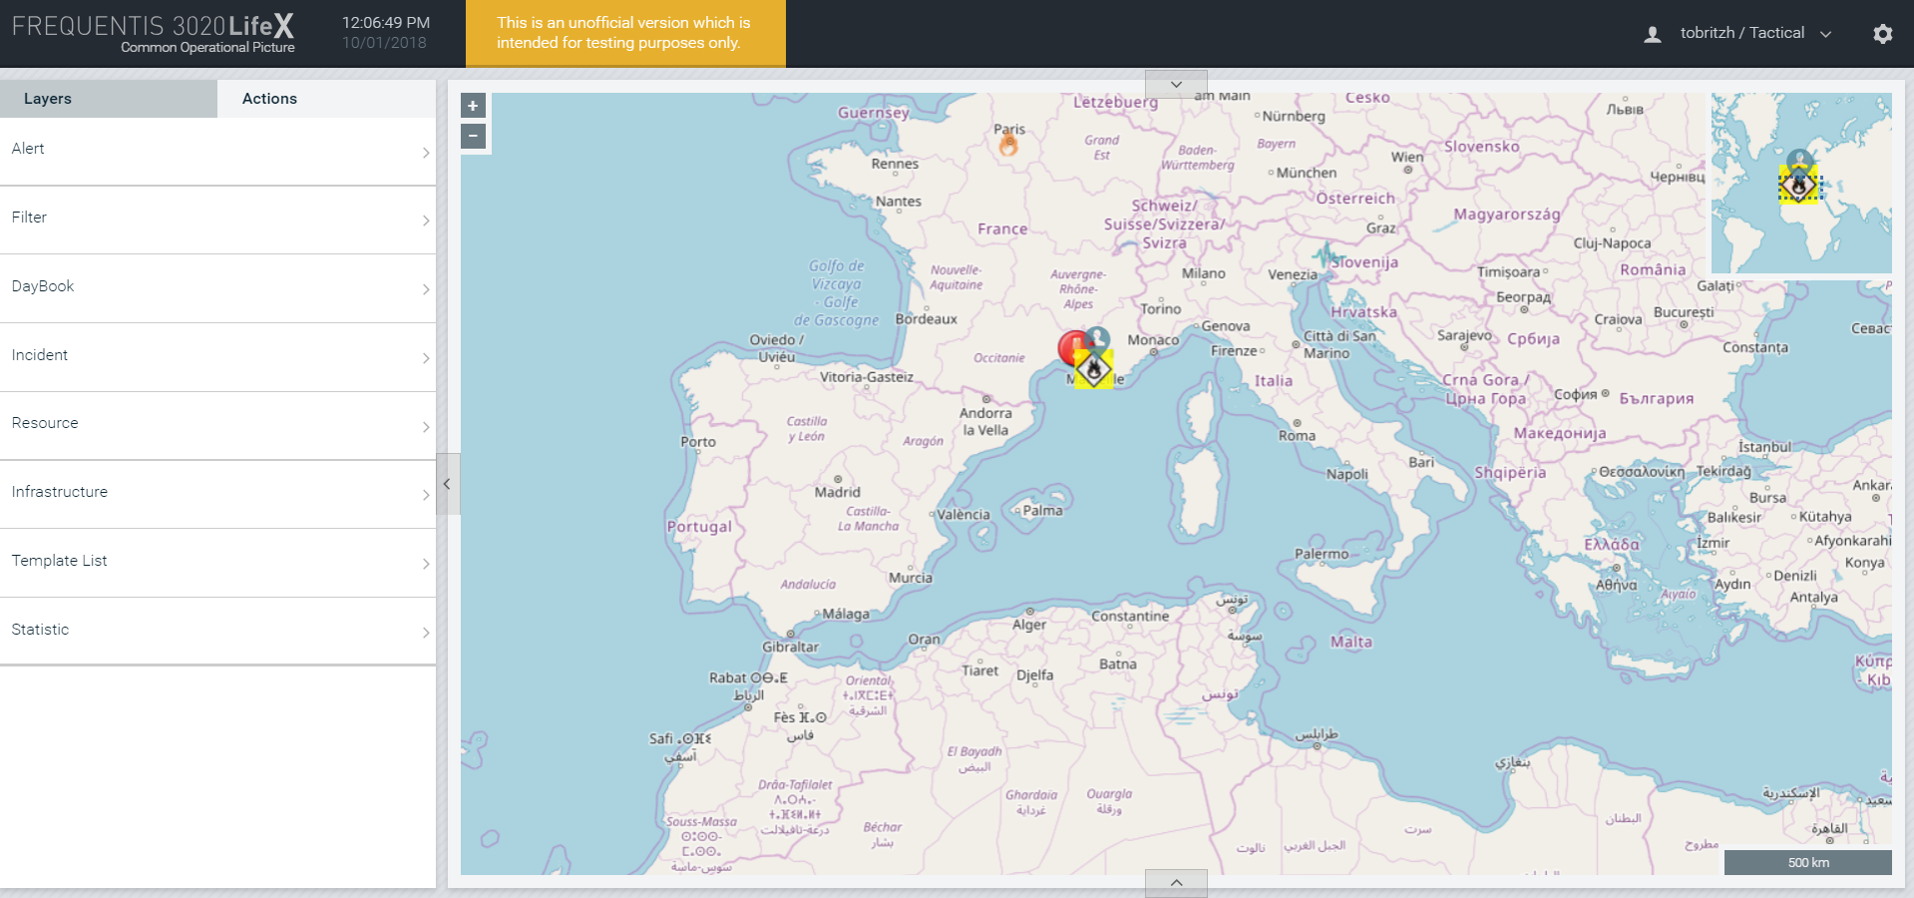
Possible actions

Slide 14
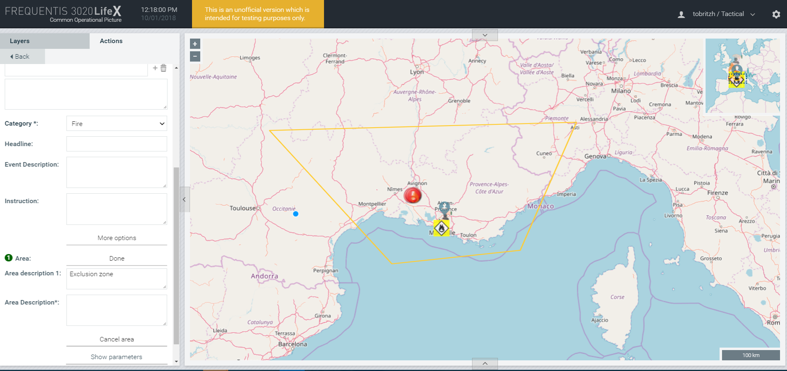
Creating an alert

Slide 15
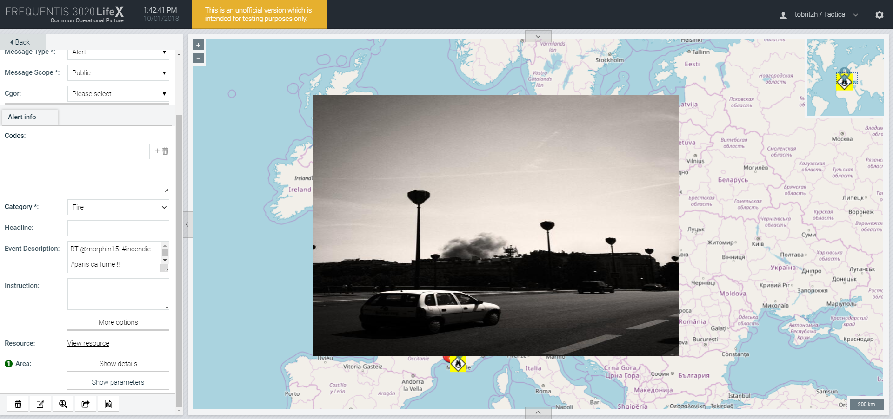
Resource of an alert

Slide 16
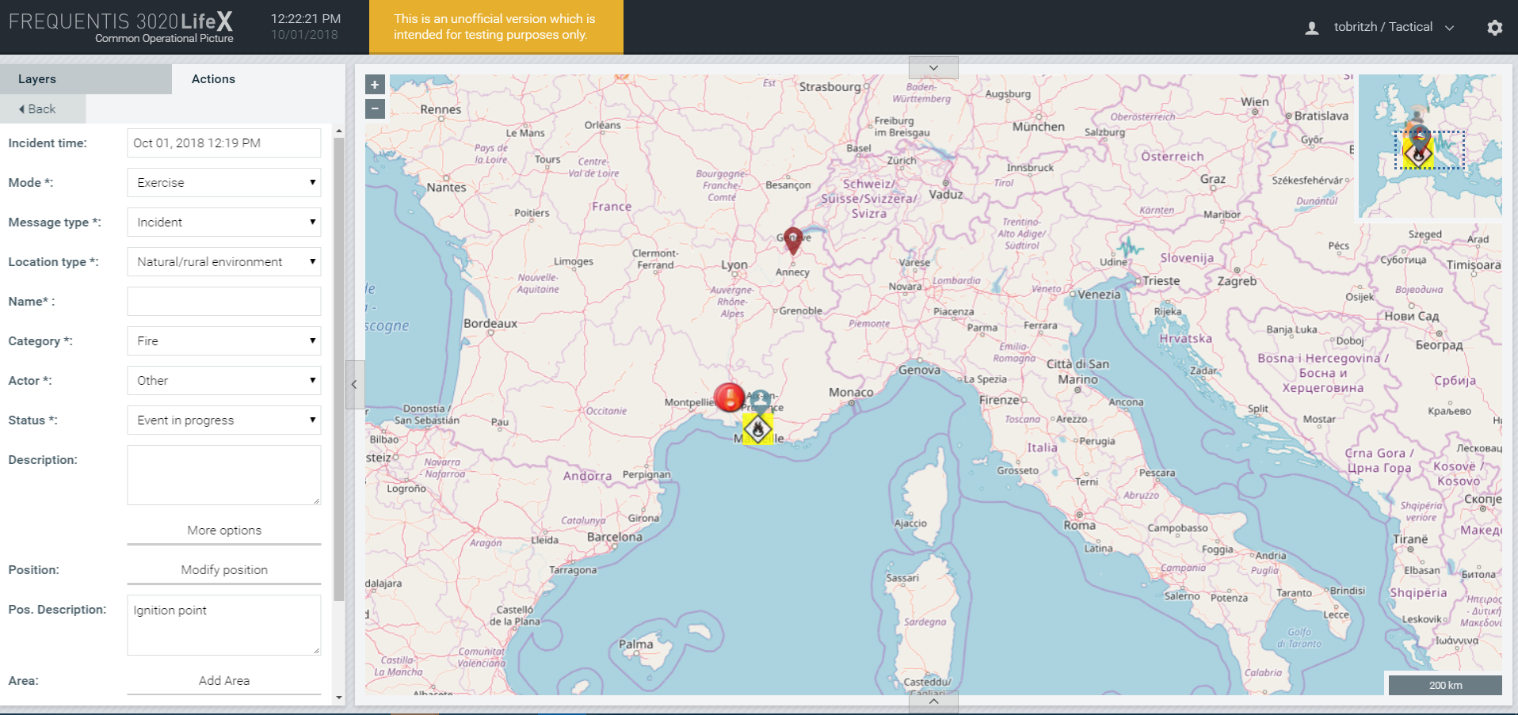
Creating an incident

Slide 17
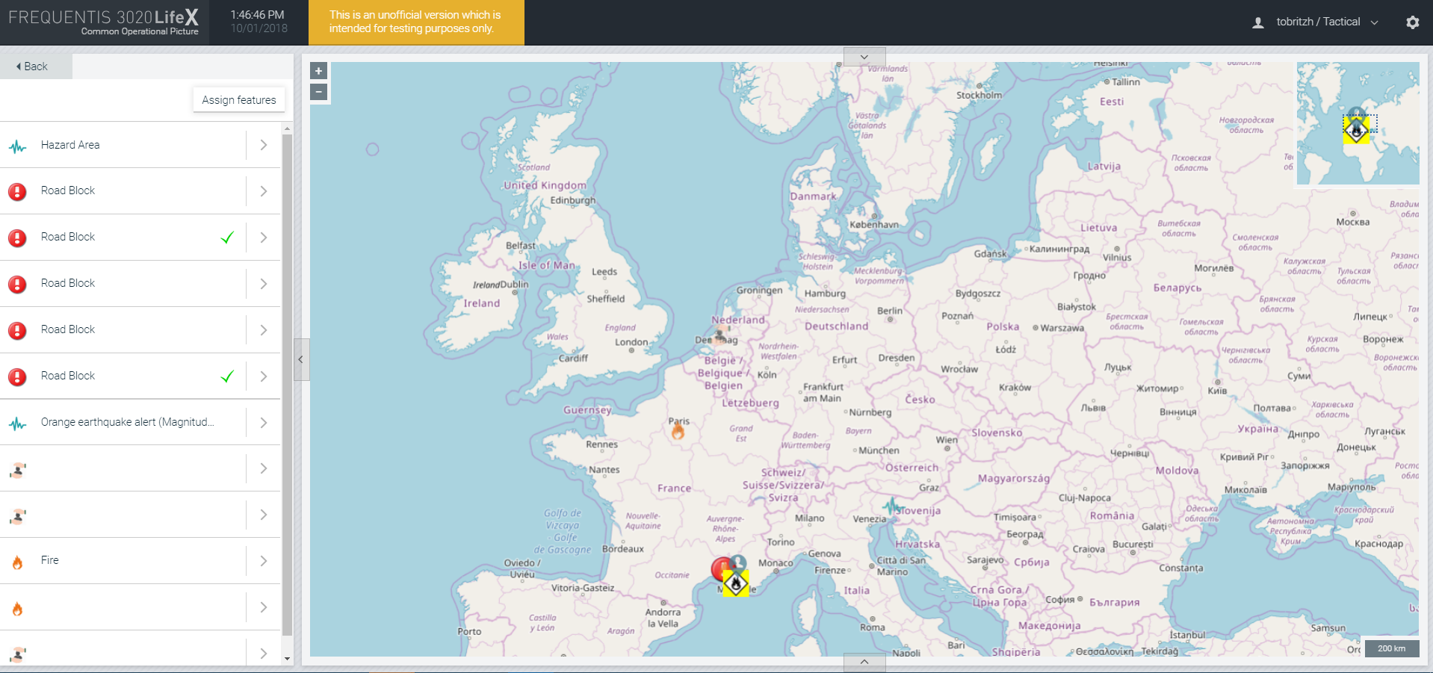
Assignment of alerts to an incident

Slide 18
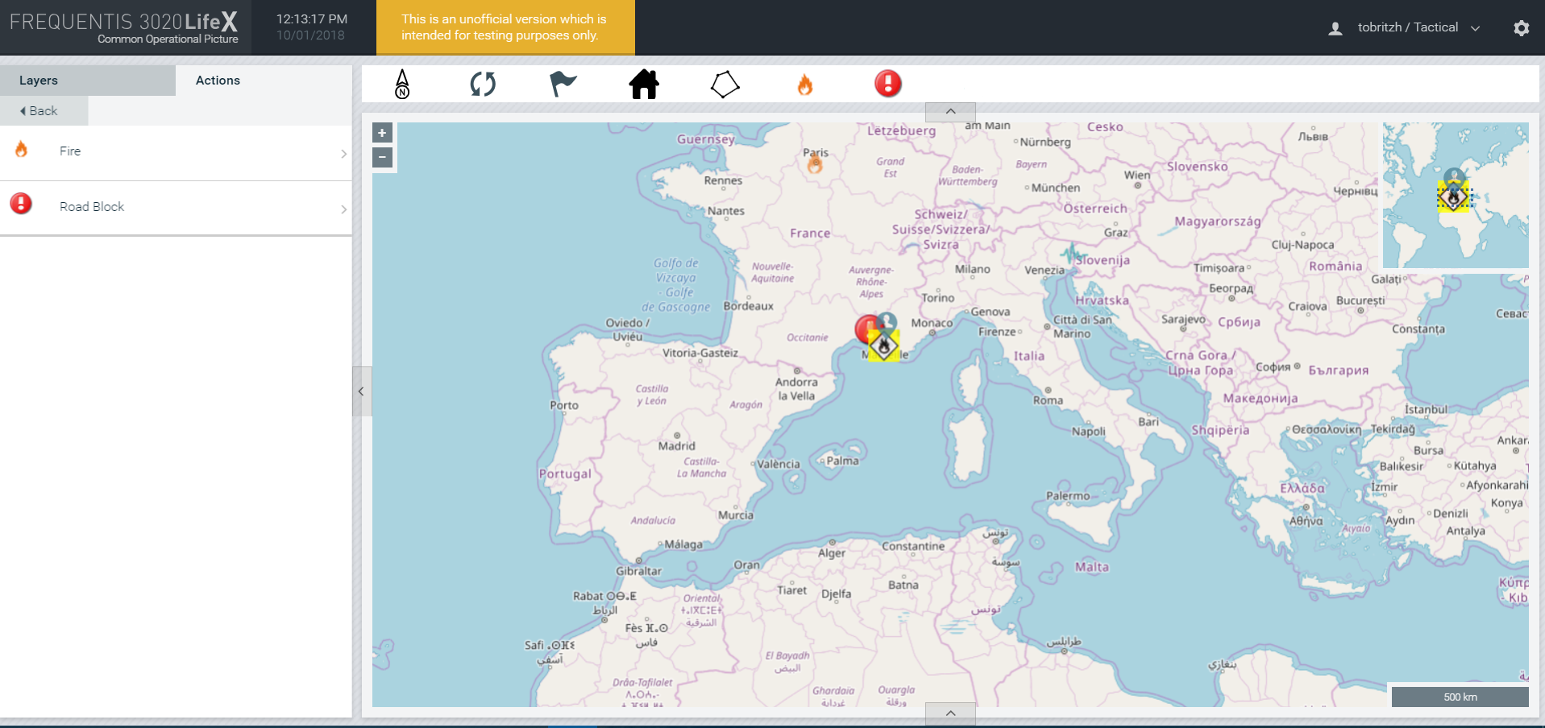
Templates

Slide 19
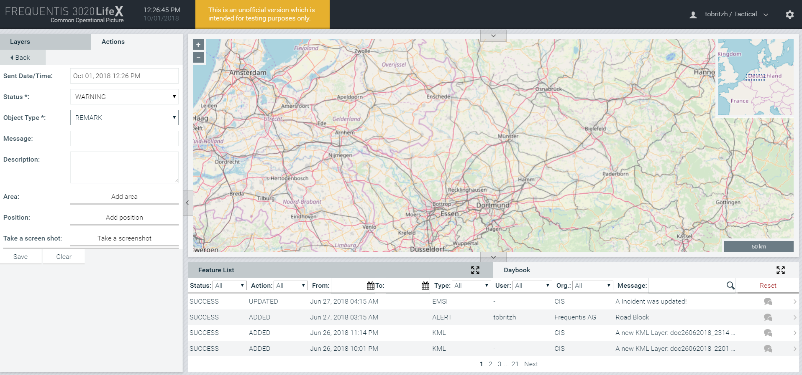
Daybook

