Slide 1
ZKI
Hands-On training
Elisa Schröter, Ralph Kiefl
10.04.2019 – The Hague

Slide 2
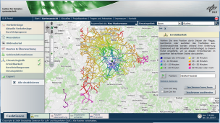
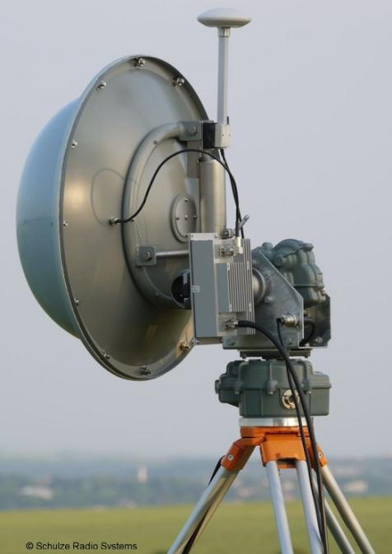
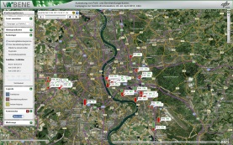
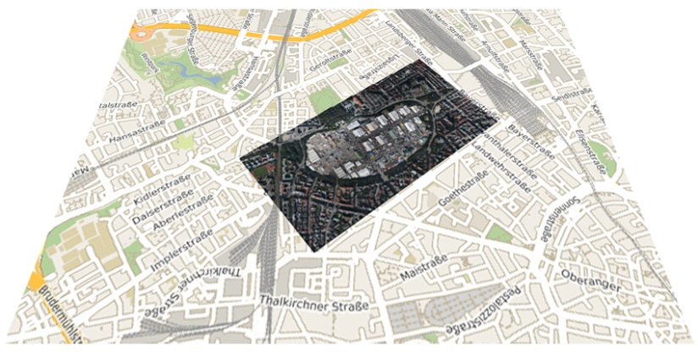
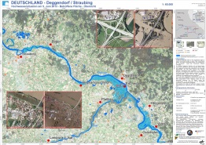
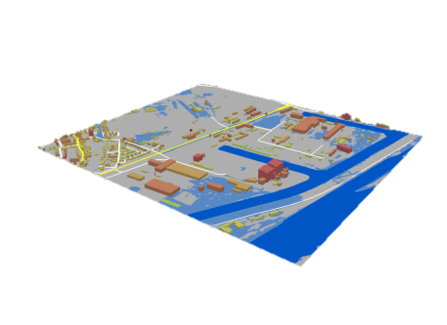
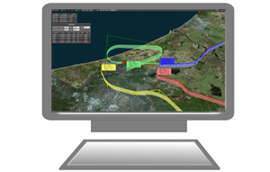
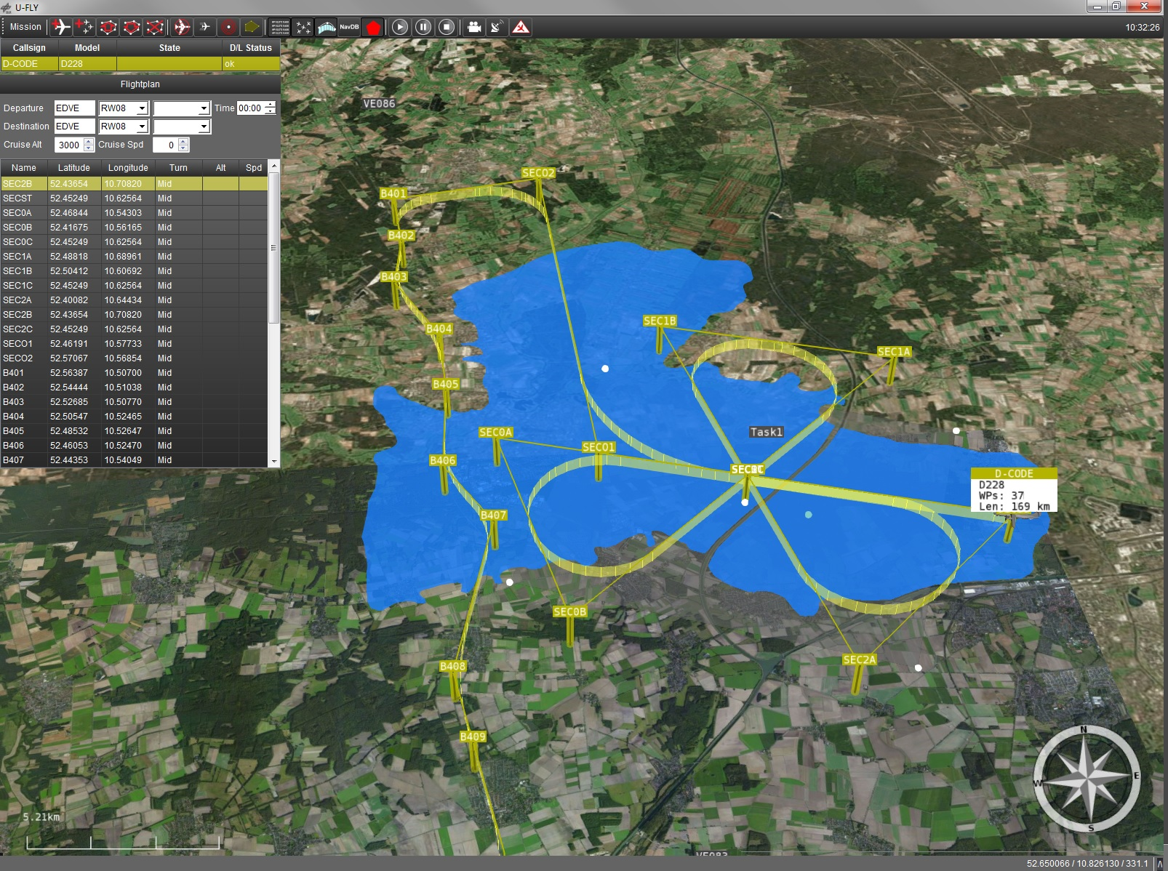
Airborne and Terrestrial Situational Awareness
BackgrounD DLR Solution
Command & Control
Camera System
C³ Data Link
Image Data Link
Dissemination, Visualisation & Interaction
Ground Control Station U-Fly
Terrestrial Traffic Sensors
Ground Station &
Processing Unit
training session
Module: ZKI

Slide 3
ZKI OVERVIEW
Main Features for Trial 4
DLR user Service ZKI (Center for Satellite based Crisis information)
Provides information layers (e.g. actual water mask) and ready to use 2D / 3D maps
For large scale events
For professional responders
Deployed in the response phase
… to assess disaster extent
… to support damage assessment
… to contribute to COP (e.g. tools such as LCMS, Crisis Suite)
… to support decision making (e.g. tools such as KeepOperational)

Slide 4
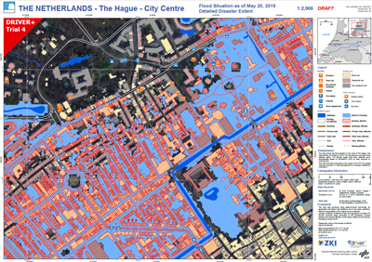
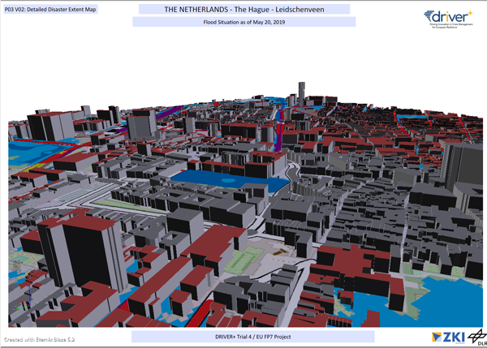
ZKI OVERVIEW
Services & Products for Trail 4
Preparation of crisis related information
water mask derived from remote sensing data
In this Trial: simulated water mask, as if derived from aerial imagery and
processed based on DLR user service ZKI processing facilities
Web based Product Dissemination
OGC WMS / WFS web services for water mask
Download service for ready to use map products
Generation of ready to use maps
2D GeoPDF
3D PDF

Slide 5
ZKI Hands-on Training
COntent
When and how to activate ZKI and receive mapping products
Accessing web services for actual water masks
Accessing and working with ZKI 2D GeoPDF map documents
Accessing and working with ZKI 3D PDF map documents

Slide 6
ZKI Hands-on Training
As soon as
IMMINENT THREAT is known
>>> send request to ZKI asap
Preparation/ Prevention
WHEN to activate
Alertness*
Risk Analysis
Disaster event
Reconstruction
Emergency Relief
Transition Phase Relief and Reconstruction

Slide 7
ZKI Hands-on Training
How to activate
Request Email
Who activates (inquiring authority and contact person)
Type of event (natural disaster / police investigation / …)
Product type (satellite imagery or aerial imagery / disaster extent analysis / …)
Product format (WMS / WFS layer for COP tools / map product)
Delivery date (fast mode - as soon as possible - / date: … )
Area of interest (name of location)
Additional comments/requests
Please send the request Email to Trial Email Account „ZKI“. if you have any questions in advance oR need Consultation on your inquiry please call +49 8153 28 44 33 88

Slide 8
ZKI Hands-on Training
Accessing web services for actual water masks
OGC Web Map Service (WMS): Viewing service https://www.opengeospatial.org/standards/wms
Used for visual overlay other layers in map applications (e.g. LCMS, Crisis Suite)
Provides rendered and geo-registered images of geodata
Supports different projections and file formats
Request-Parameters: Layer, area of interest, size, image format, spatial reference
OGC Web Feature Service (WFS): Data service for vector data https://www.opengeospatial.org/standards/wfs
Accessed for further geoprocessing (e.g. KeepOperational, GIS applications)
Supports different projections and file formats
Request-Parameters: Layer, area of interest, file format, spatial reference

Slide 9
ZKI Hands-on Training
Accessing web services for actual water masks
https://geoservice.dlr.de/eoc/zki/service/driver/wms?
Service | WMS
Request | GetMap
Layers | driver:dryrun1_watermask_tsx_sim
AOI LL | 4.2318027°E 51.962462°N
AOI UR | 4.395028°E 52.113057°N
Image Width | 951
Image Height | 878
Spatial Reference | 4326 Geogr./ WGS84
Format | PNG
Please Open Shortlink: http://s.dlr.de/250h

Slide 10
ZKI Hands-on Training
Accessing web services for actual water masks
https://geoservice.dlr.de/eoc/zki/service/driver/wms?
Service | WMS
Request | GetMap
Layers | driver:dryrun1_watermask_tsx_sim
AOI LL | 75572 442084
AOI UR | 87017 458670
Frame Width | 1024
Frame Height | 768
Spatial Reference | 28892 (Amersfoort / RD New)
Format | application/openlayers
Please Open Shortlink: http://s.dlr.de/mh8c

Slide 11
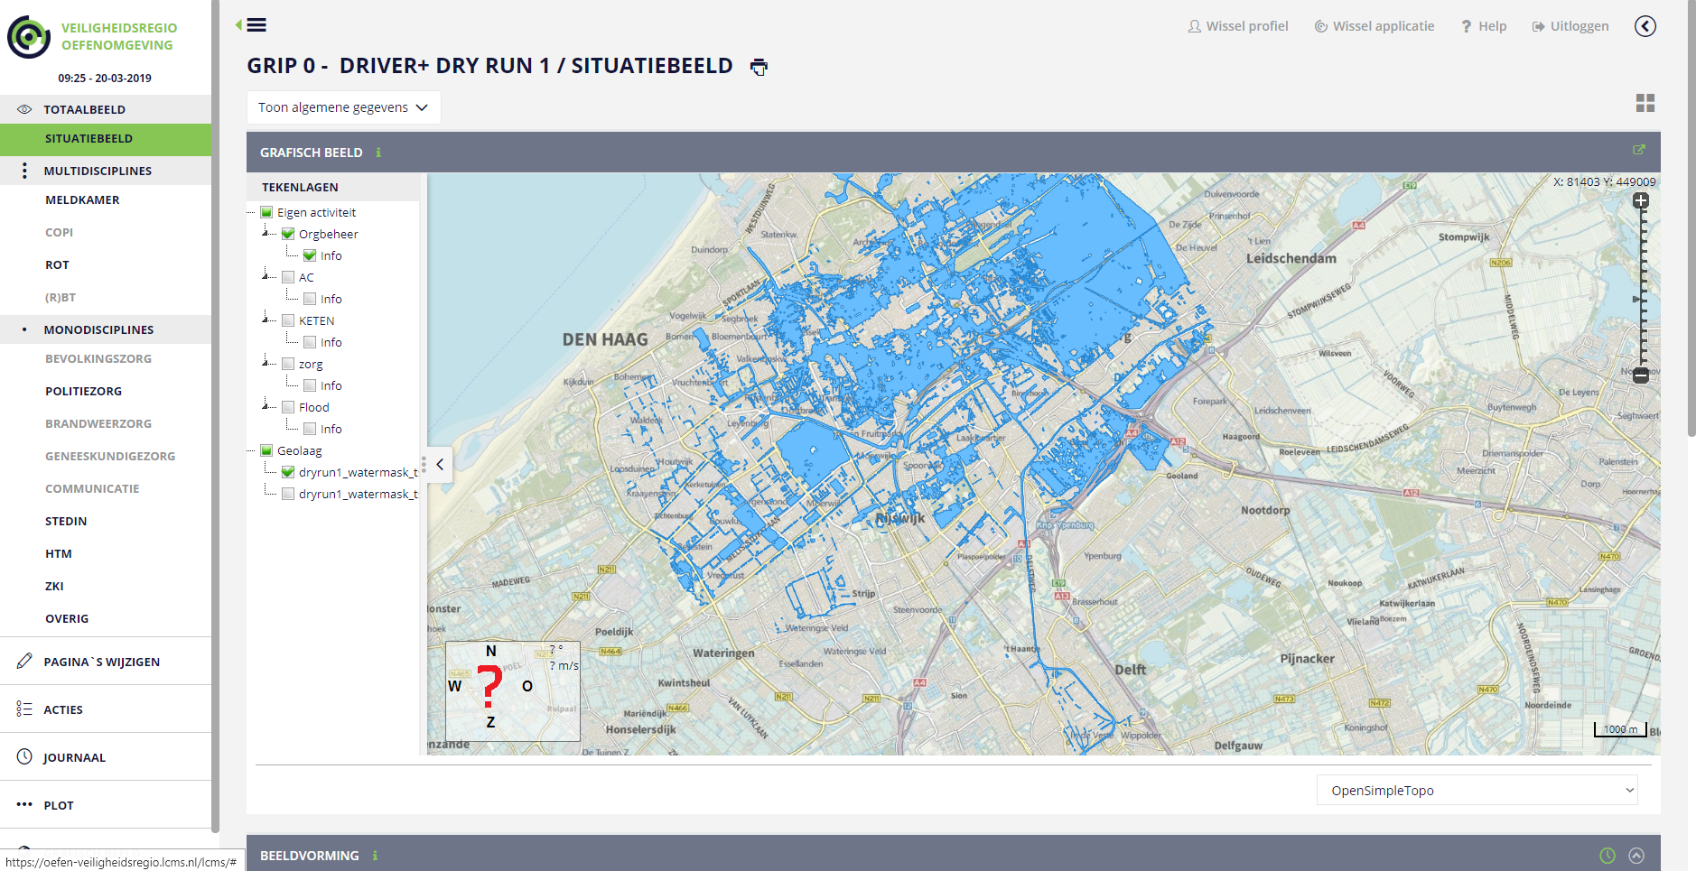
ZKI Hands-on Training
Accessing web services for actual water masks
https://geoservice.dlr.de/eoc/zki/service/driver/wms?
Service | WMS
Request | GetMap
Layers | driver:dryrun1_watermask_tsx_sim
AOI LL | 75572 442084
AOI UR | 87017 458670
Frame Width | 1024
Frame Height | 768
Spatial Reference | 28892 (Amersfoort / RD New)
Format | application/openlayers
Demo watermask service layer displayed in LCMS (image provided by TNO)

Slide 12
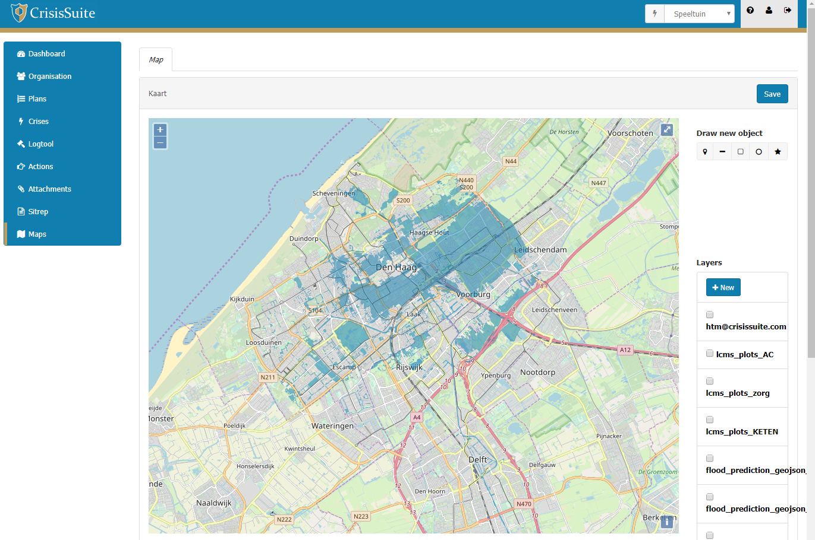
ZKI Hands-on Training
Accessing web services for actual water masks
Demo watermask service layer displayed in CrisisSuite (image provided by MERLIN)

Slide 13
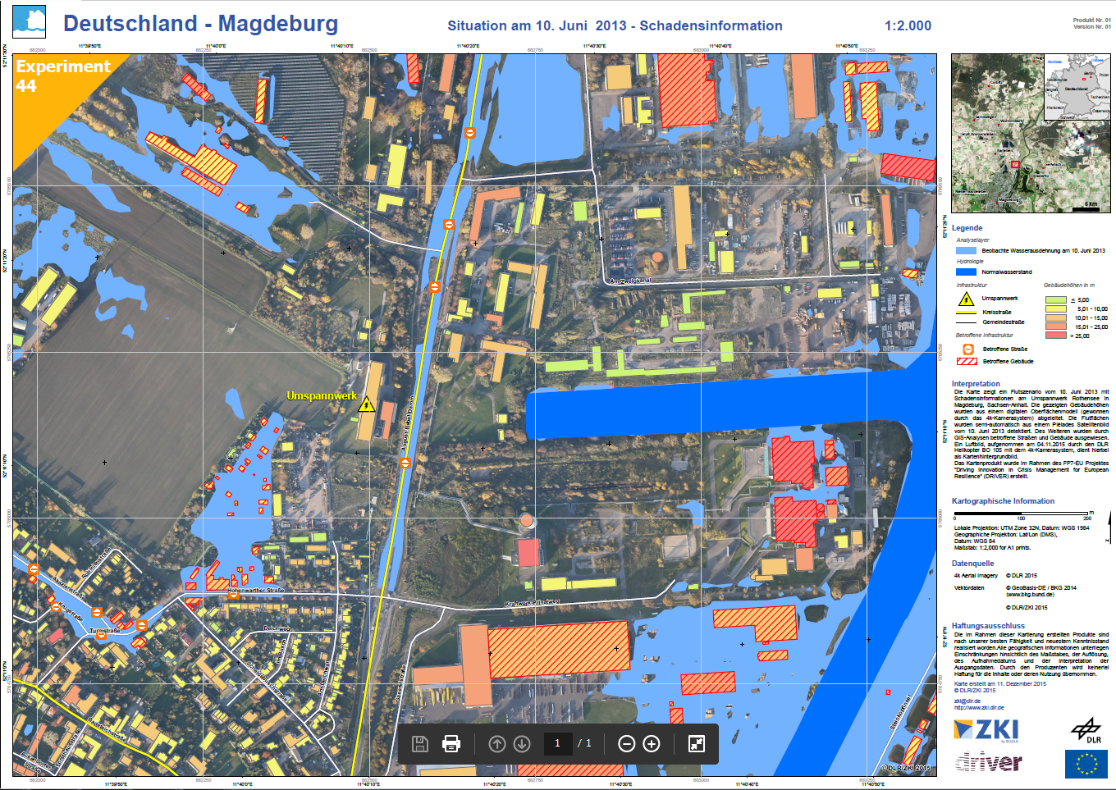
ZKI Hands-on Training
Accessing and working with ZKI 2D GeoPDF map documents
Please use Shortlink
http://s.dlr.de/2968
Download and open FILE:
DRIVER-Exp44_GeoPDF_Magdeburg.pdf
Open & access toolbars
Toggle map layers for custom map view
Make messurements
Make comments
Access attribute information

Slide 14
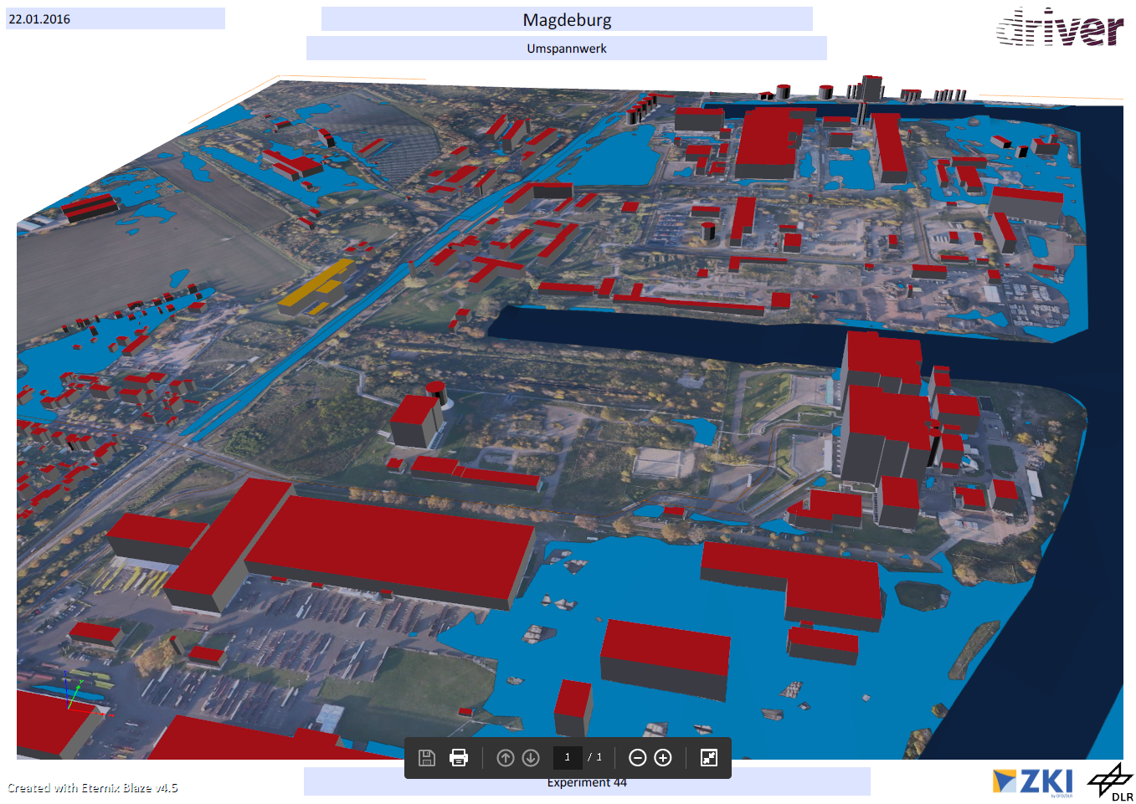
ZKI Hands-on Training
Accessing and working with ZKI 3D PDF map documents
Please use Shortlink
http://s.dlr.de/m878
Download and open FILE:
DRIVER-Exp44_3D_PDF_Magdeburg.pdf
Open & access toolbars
Navigate through 3D environment
Toggle map layers for custom map view
Make messurements
Make comments
Access attribute information

Slide 15
zki@dlr.de
www.zki.dlr.de

