Slide 1
KeepOperational
Introduction
Ronald Nippold, Eric Neidhardt, Carsten Dalaff
10.04.2019 – The Hague

Slide 2
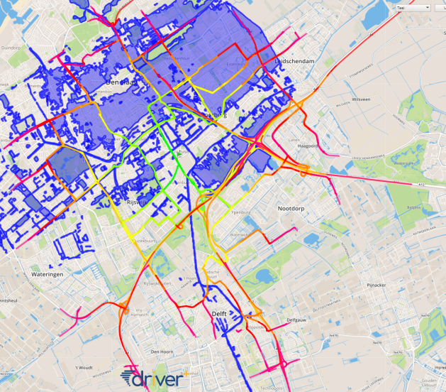
KeepOperational
Situational Awareness
Web-Service for efficient transport planning for professional responders

Slide 3
KeepOperational
Main Features
Feature | Issue
Monitoring | Repeatedly data acquisition and derivation of information allows for change detection analyses (not addressed in the trial)
Assessment | Determination of disaster extent
Decision support | Disaster extent and traffic situation (not addressed in the trial)
Logistics | Optimised route planning for convoys / special vehicles
For large scale events
For professional responders

Slide 4
KeepOperational
Modules/Functionalities
Basic Map
Routing
Accessibility
Net adaption

Slide 5
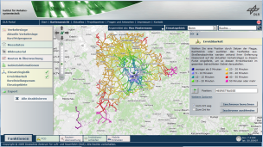
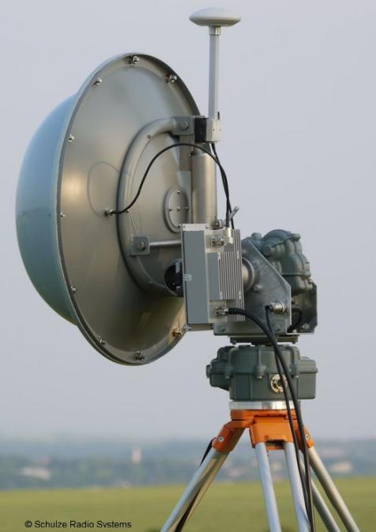
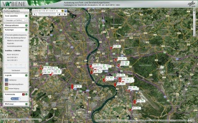
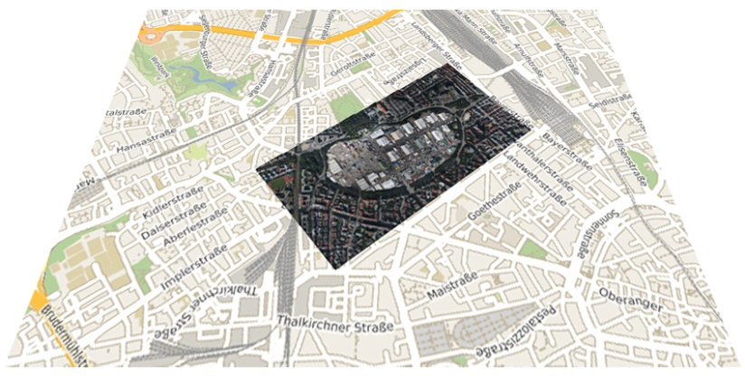
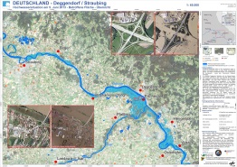
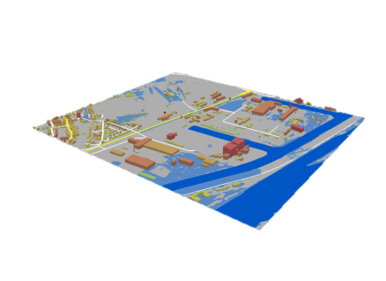
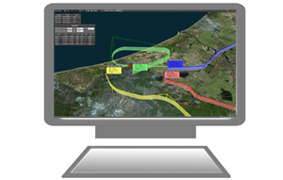
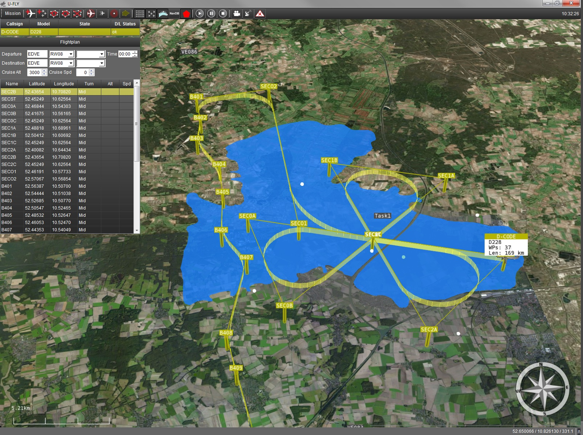
KeepOperational
Background information
Command & Control
Camera System
C³ Data Link
Image Data Link
Ground Control Station U-Fly
Terrestrial Traffic Sensors
Ground Station &
Processing Unit
Dissemination, Visualisation & Interaction

Slide 6
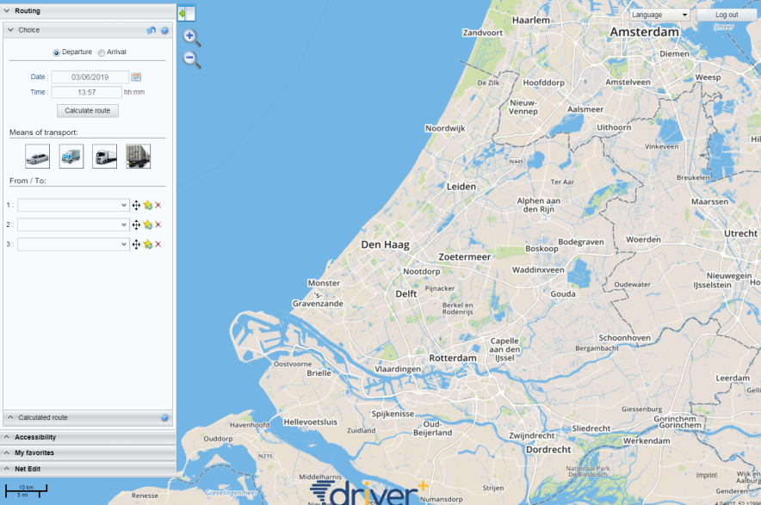
KeepOperational
Dashboard
Start screen after login
Functions in left Menu
Map center on Den Haag

Slide 7
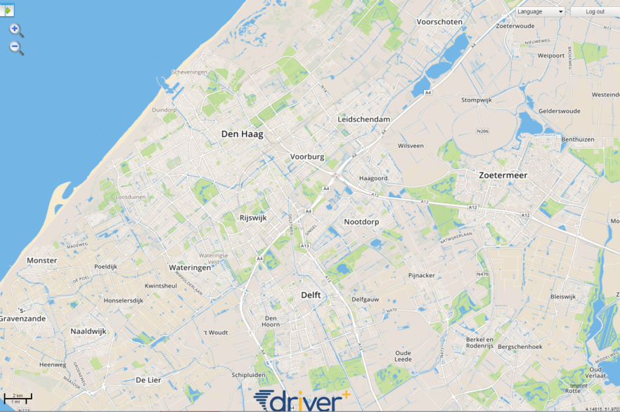
KeepOperational
Basic MAp
Scroll
Zoom in/out
Change language

Slide 8
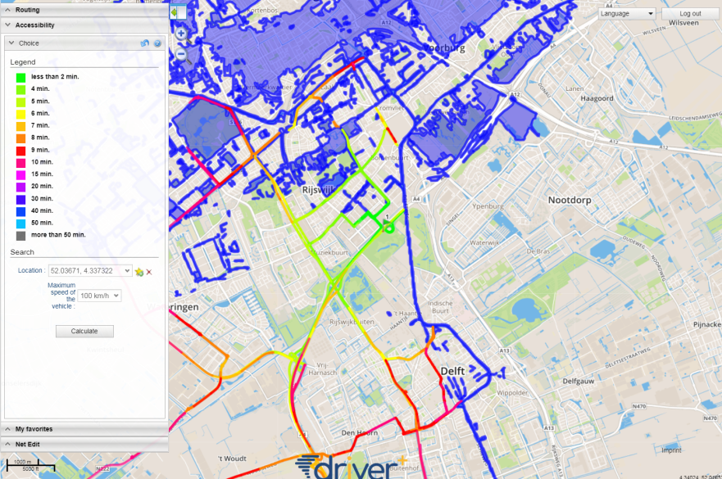
KeepOperational
Accessibility
How is the accessibility of a certain area affected by the flooding?
How long does it take for emergency vehicles to reach any destination in the vicinity?
Support for planning the optimal position of a operation base, shelter ... in the field

Slide 9
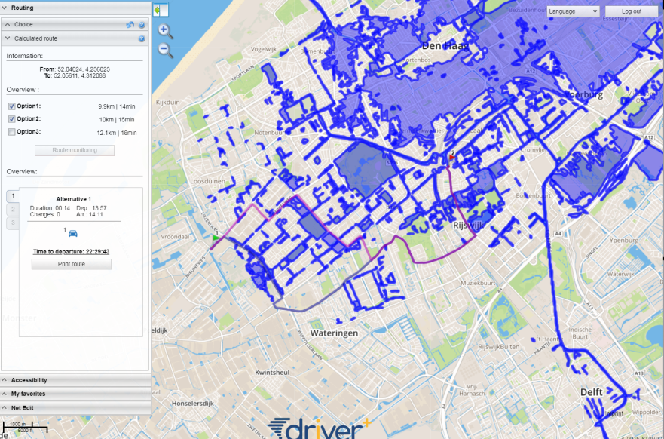
KeepOperational
Routing
Considers traffic situation and crisis situation
First response specific routing (e.g. large vehicles etc.)
Selection of vehicle classes
Various route alternatives

Slide 10
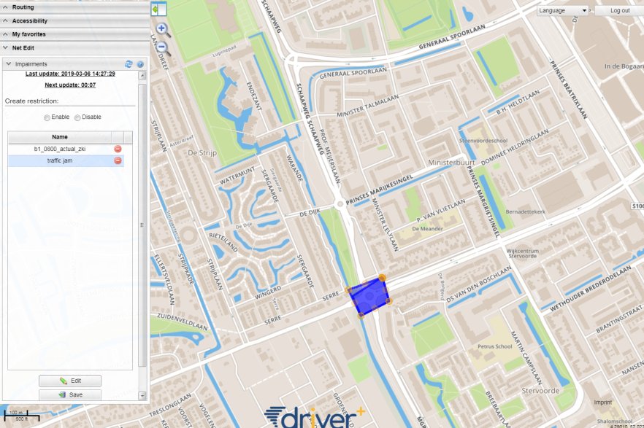
KeepOperational
NET Adaptation
Show/hide flood mask
Manually add, edit or delete closures to the map (traffic jams, closures, new information)
Incorporate information from units in the field
Flood masks and manually added restrictions are considered by the routing algorithm

