Slide 1
KeepOperational
Hands-On training
Ronald Nippold, Eric Neidhardt, Carsten Dalaff
10.04.2019 – The Hague

Slide 2
KeepOperational
GeneRal
Keep Operational is a web portal developed by DLR that allows the visualisation of the current traffic situation from different traffic data sources. The traffic data serves as a basis for traffic simulation and prediction as well as a traffic management tool for decision-makers for traffic-related planning and support of emergency forces in the event of a crisis.
Keep Operational provides traffic information, e.g:
Traffic situation,
Routing,
Alternative routes,
Traffic forecast,
Accessibility depending on the traffic situation,
Presentation of aerial photographs.
With the help of the traffic information it is for instance possible to query optimal routes by taking into account the current traffic situation and specifying various route options.

Slide 3
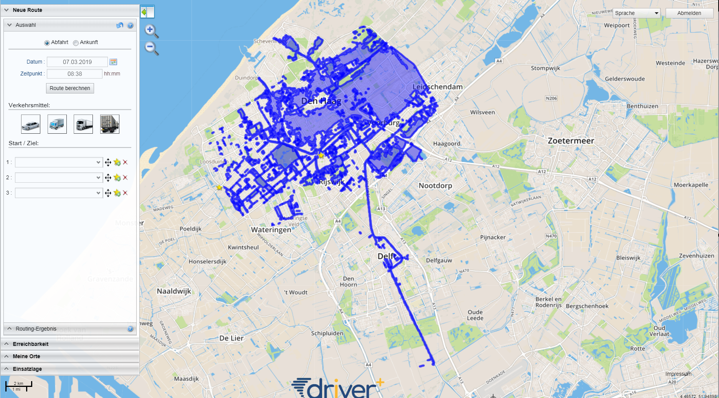
KeepOperational
Structure – four Areas
Select Language
Menu area
Header
Log out
Visualization
Digital map
Function boxes
Footer
Notes:
Kopfbereich:
Der Kopfbereich beinhaltet eine Suchmaske und bietet die Möglichkeit, die Sprache zu ändern und sich abzumelden.
Fußbereich:
Der Fußbereich ist wie der Kopfbereich ein statischer Inhalt, der unveränderlich das Logo des Projektes (Mitte) und das Impressum (rechts unten) enthält und die aktuelle Position des Mauszeigers in der Karte als Koordinaten (rechts unten) sowie den Maßstab (links unten) anzeigt.
Menübereich:
Der Menübereich gliedert die Funktionalitäten, deren Umfang in der Bedienung näher erklärt wird.
Visualisierungsbereich:
Die Visualisierung dient der Darstellung von dynamischen, georeferenzierten Inhalten. Er enthält darüber hinaus die Bedienelemente zum Zoomen (‚+‘ und ‚-‚) am linken Rand sowie die Auswahl der zur Verfügung stehenden Layer. Diese werden durch Anklicken des Layer-Symbols aufgeklappt. In den Layern stehen zusätzliche georeferenzierte Inhalte wie z.B. die Verkehrslage, das Wetter, Beschriftungen etc. zur Verfügung (vgl. Abbildung unten).

Slide 4
KeepOperational
Functionalities
The portal provides the user with the following functionalities:
Route calculation,
Search by clicking on a map / current position,
Route calculation according to the route options: (Typical) weekday, date, time, means of transport, convoy; traffic/crisis situation,
Up to 3 alternative routes for each selected start-destination route search,
Display of closures (road closures, flood…) and consideration blockages within the routing,
Display of lines of the same travel time, based on the current travel times (accessibility),
Create favorites

Slide 5
KeepOperational
Which Tasks/Questions can be Solved Via KeepOperational
A Road has to be closed due to fallen trees – Which impact has this for the routing?
A road has to be used as evacuation street for the hospital – Which road should be used as „evacuation street“? Which impact does this have?
Which alternative routes exits?
A convoy needs to be routed from A to B
Where is an optimal location for a base to cover a certain area regarding transport aspects?

Slide 6
KeepOperational
Hands oN training
We will now login and do a number of exercises
User: tdp@dlr.de
Pass: #Tdp#

