Slide 1
Sim-ci
Introduction dry-run 2 training
Eelco Naarding
…

Slide 2
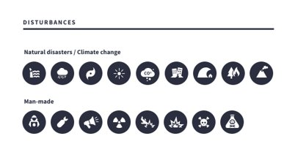
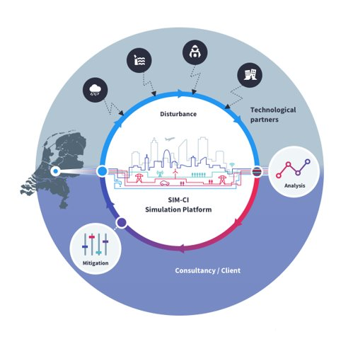
Our propositions

Slide 3
1. Create Digital Twin 2. Calculate disruption 3. Determine cascade effects
Approach:
Result
Digital Twin City
Stressful event
Consequential damages
Quantified outcomes
Localisation of crucial parts
Effect of mitigations
4. Analyse impacts 5. Distinguish vulnerabilities 6. Take mitigating actions
2
6
3
5
4
recover
prevent

Slide 4
Demonstration of solution

Slide 5
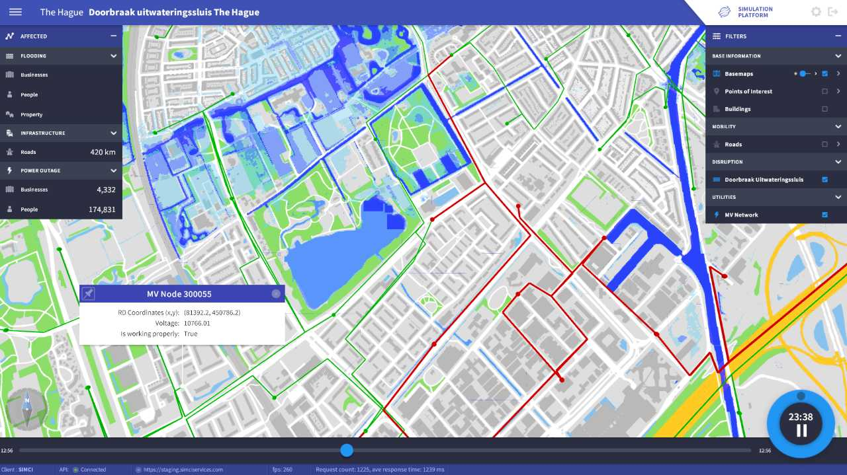
Sim-ci
Simulating critical infrastructures

