Slide 1
3di for crisis management
Practical training
Ciska Overbeek, Nelen & Schuurmans
25th of April 2018
Notes:
Give an overview of 3Di
Show crisis managers how to use 3Di
Get some hands on experience with 3Di yourselves

Slide 2
A flood scenario (movie)
Notes:
What is 3Di? 3Di is a process-based, hydrodynamic model for flooding, drainage and other water management studies. Hydrologist needed for full comprehension of model and results.
To give an introduction to 3Di in 1 minute and give a first glimpse at interface.
15h simulation, breach of Oroville dam

Slide 3
Goal of 3di practical training
To get an overview of 3Di
To understand the possibilities of the 3Di portal for setting up a scenario
To get an overview of possible 3Di results
To get an overview of the connection between 3Di and Socrates
Notes:
Expert hydrological knowledge needed to really understand the model.

Slide 4
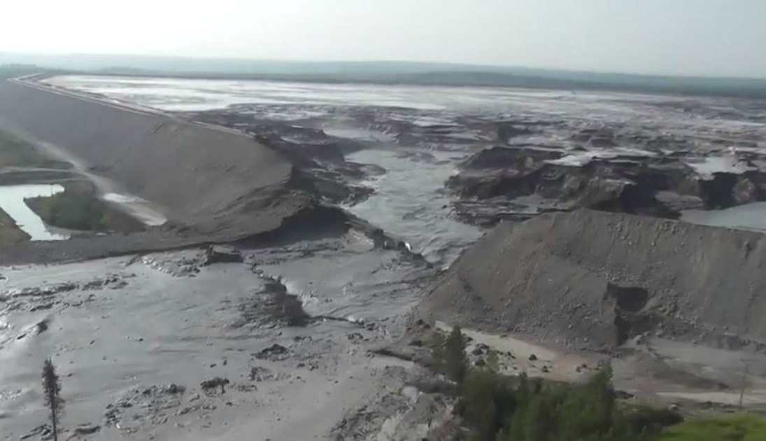
terminology
Breach and levee:
Notes:
As not to confuse terminology, used in model
Breach in a dam
Levee/flood bank/dike

Slide 5
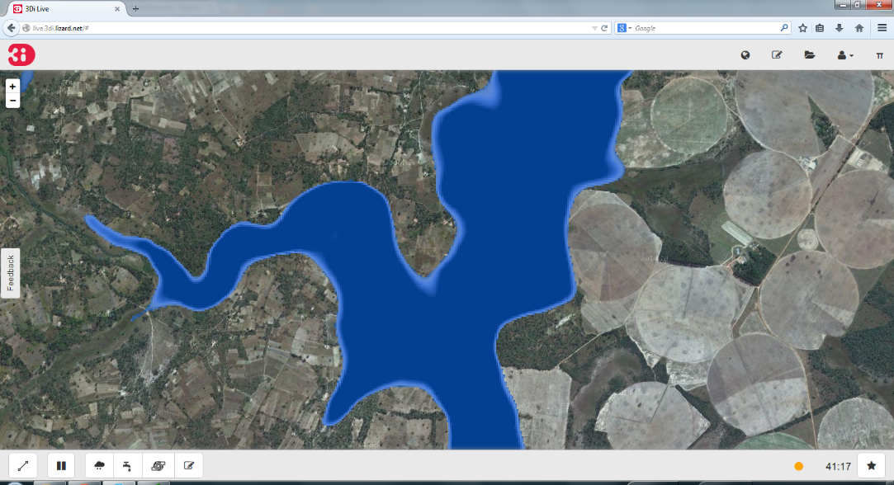
A water simulation model to bridge the gap between specialists and stakeholders
Notes:
Visual and interactive (add rain, open a breach, etc)
Fast and accurate. Benchmark studies, one of best models.

Slide 6
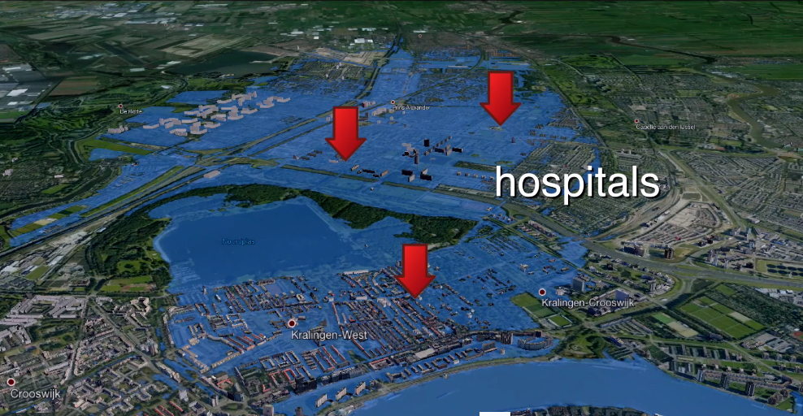
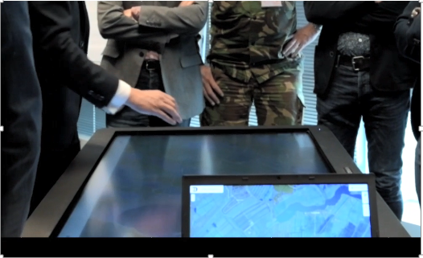
Role of 3Di
Risk assessment
Raise awareness and situational awareness among all stakeholders
Stimulate to get all knowledge and experience to come at the table
Optioneering for mitigation/response and recovery measures
Notes:
Maintain situational awareness for all stakeholders, stimulate all knowledge and experience to come at the table
Support recovery, engage population and optioneer for solutions
e.g.: - Paramatta (Australia): alerting messages for flooding in catchment, - Friesland: 3000km levees with breach every 100m

Slide 7
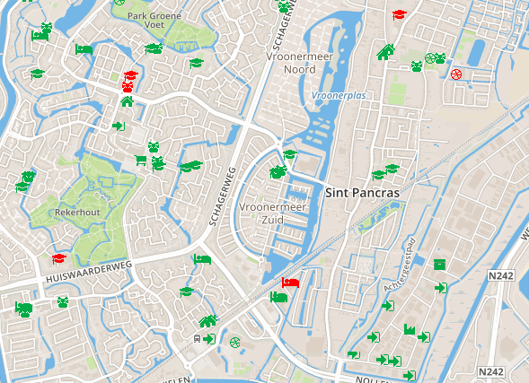
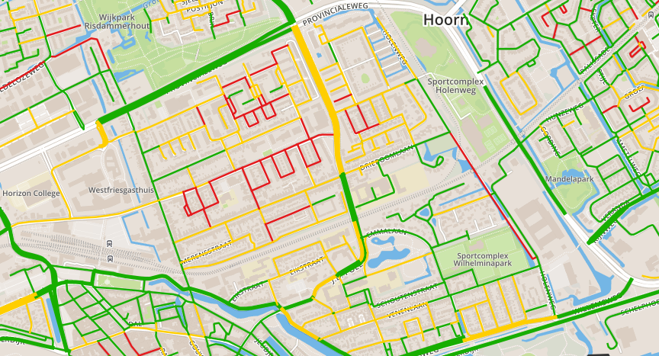
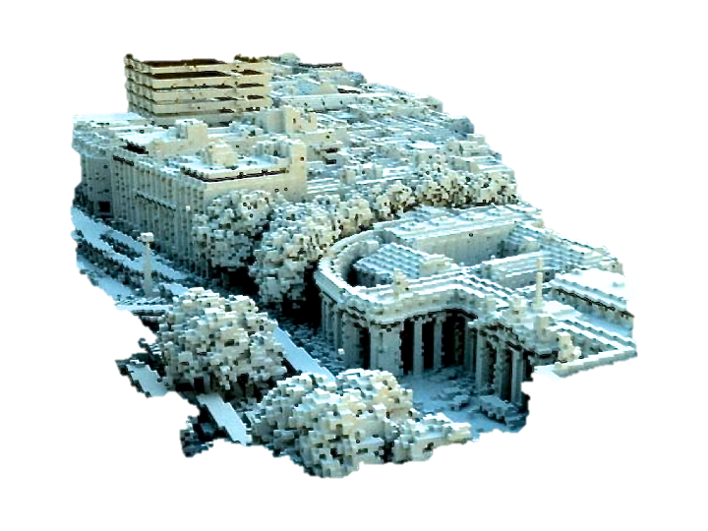
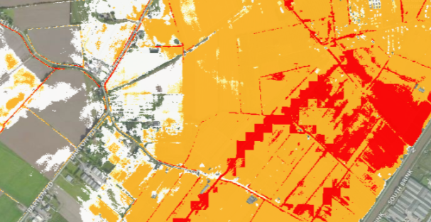
How to use 3Di?
MODEL
USE and ANALYSe
Notes:
Size of Digital Elevation Model and size of calculation cells determines detail of model, but also speed. So for crisis management 5x5m DEM. Detailed enough for crisis management overview. Made to perform quickly, so some small artefacts accepted (e.g. blue spots (water) at start, due to slope and size of calculation cells, but if smaller → slower)
Results to lizard (data portal), download geotiffs (raster-files) for Socrates

Slide 8
Hands on – go through 3di portal together
Divide into 5 groups
2-3 practitioners per group
Practitioners at the computers, others can follow my screen
Notes:
Audience: this part is aimed at practitioners to be able to run simulation in 3Di, observers to know options and buttons, others can follow if they want but this part is specifically aimed at practitioners and observers

Slide 9
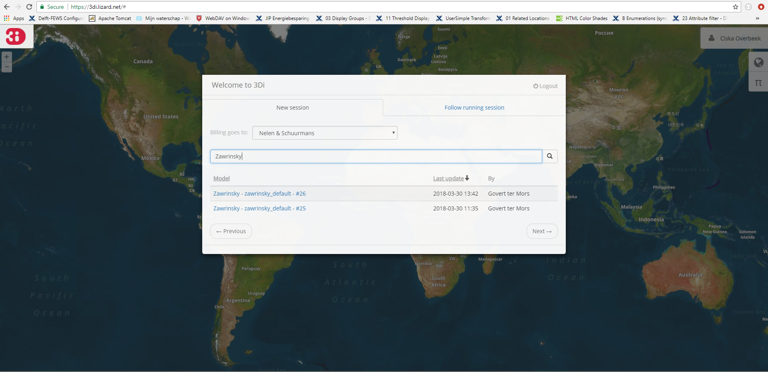
Hands on: 3di portal
3di.lizard.net
Notes:
Go to 3Di portal (leave ppt)

Slide 10
Hands on: 3di portal
3di.lizard.net
Now try it for yourself!
Repeat the steps we did together
See how quickly you can flood the area
See which parts stay dry

Slide 11
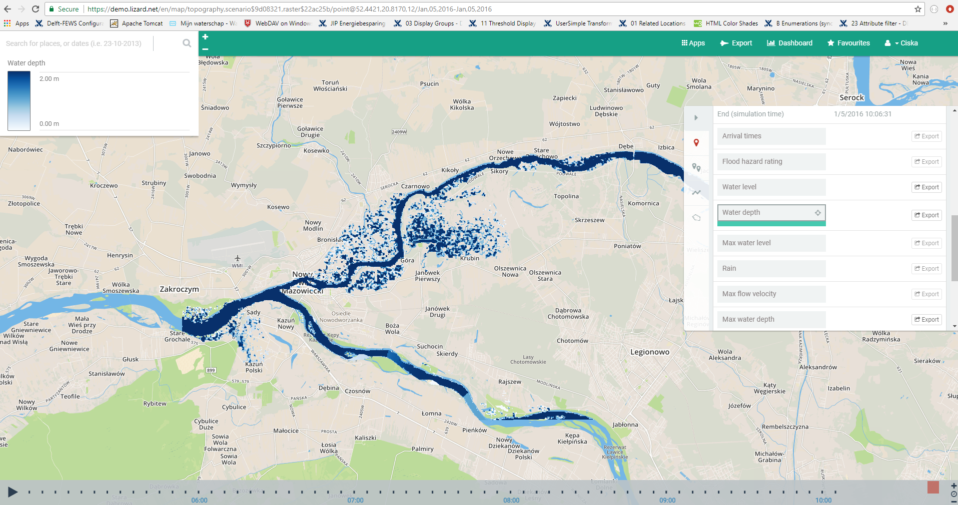
Results in lizard
Demo.lizard.net/en

Slide 12
Getting Results in socrates
In Trial1 not all practitioners have access to 3Di
Results will be shared through Socrates
Water arrival times
Water depth for different time steps after start of simulation

Slide 13
Wrap up
3Di portal
Run simulation
Make scenario visual and interactive, stimulate communication and situational awareness
Process results
Lizard
Processed and evaluated results
Export geotiffs for arrival times and water depth
Socrates
Share 3Di results

Slide 14
THIS IS A SLIDE TITLE
THIS IS A SLIDE SUBTITLE
Content of the slide
Bullet point level 1
Bullet point level 2
Bullet point level 3
Bullet point level 4

